Slide 1




BUSINESS ENGAGEMENT
Building Relationships, not Transactions

Slide 2


What is Business Engagement?
Building Relationships
Providing Support & Resources
Connecting Businesses with Talent
Educating & Raising Awareness
Offering Incentives & Solutions
Creating Long-Term Partnerships
Notes:
"Business engagement is all about building strong, mutually beneficial relationships between disability service providers and employers. The goal is to create inclusive workplaces where individuals with disabilities can thrive while also meeting business needs.
Building Relationships
"At its core, business engagement is about relationships. Employers need to trust that we understand their business, their hiring needs, and their challenges. By taking the time to listen, provide value, and offer solutions, we build long-term partnerships rather than just one-time placements."
Providing Support & Resources
"Employers may want to hire people with disabilities but feel uncertain about how to do it effectively. That’s where we come in. We provide resources such as disability awareness training, workplace accessibility guidance, and best practices for inclusive hiring. By offering this support, we make the hiring process easier and more successful."
Connecting Businesses with Talent
"A key part of business engagement is making the right match between employers and job seekers. We work to understand employer needs, then connect them with qualified candidates who have the skills to succeed. We also provide job coaching and ongoing support to ensure a smooth transition."
Educating & Raising Awareness
"Many employers have never worked with a person with a disability or may have misconceptions about accommodations or job performance. Through workshops, presentations, and one-on-one conversations, we educate businesses on the benefits of disability inclusion and help them shift their perspectives."
Offering Incentives & Solutions
"Hiring people with disabilities isn’t just the right thing to do—it’s also good for business. We help employers take advantage of tax incentives, funding for accommodations, and other resources that make hiring easier and more cost-effective. By positioning disability hiring as a solution to workforce needs, we create more buy-in from businesses."
Creating Long-Term Partnerships
"Finally, business engagement is not a one-time effort—it’s about sustaining relationships over time. We stay connected, provide ongoing support, and celebrate success stories. By doing this, we help businesses grow into champions of disability inclusion and build a culture where hiring people with disabilities becomes a standard practice."
Closing:
"When we engage businesses effectively, we create win-win situations: people with disabilities gain meaningful employment, and businesses benefit from dedicated, skilled employees. That’s the power of true business engagement."

Slide 3
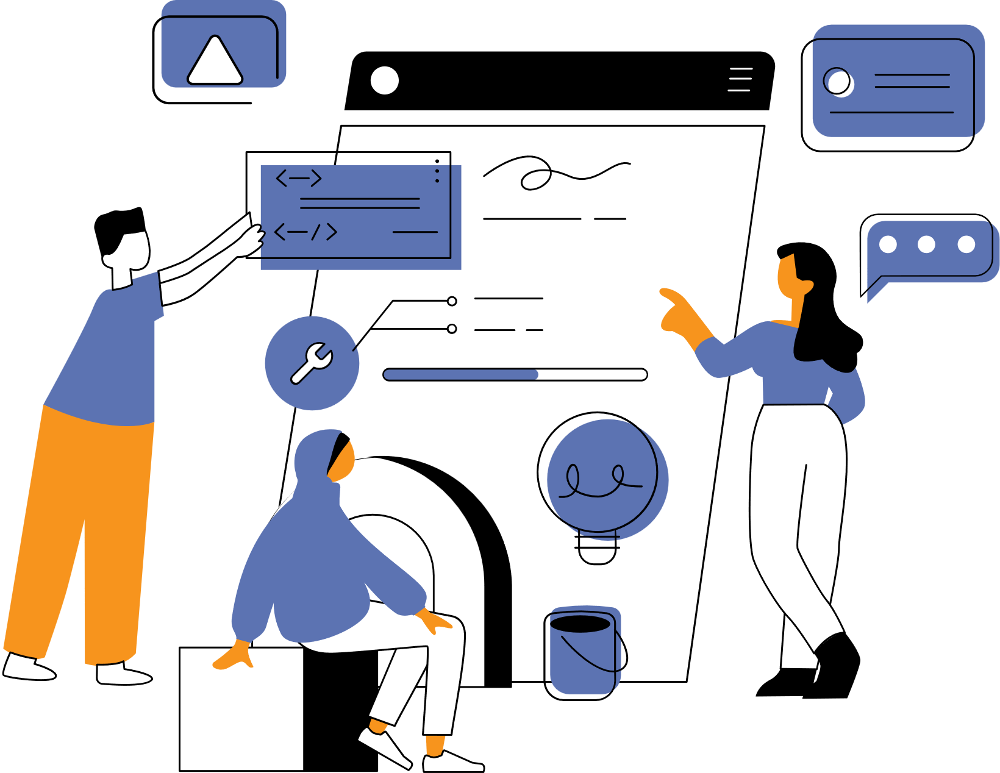

Workforce Shortages
Retention Rates
Mutual Benefit
Instead of framing disability hiring as charity, highlight how it can help businesses.
Brand Reputation and Loyalty
Notes:
1. Focus on Mutual Benefits
Instead of framing disability hiring as charity, highlight how it can help businesses:
Address workforce shortages: We know it’s a struggle to find good, quality employees right now. Use this to your advantage! Businesses are looking, fill that need.
Improve retention rates: A 2018 study by Accenture found that companies with inclusive hiring practices saw 30% lower turnover rates.
Boost brand reputation and customer loyalty: People with disabilities, along with their families and allies, represent a huge consumer base. In the U.S. alone, the disability community influences over $13 trillion in annual disposable income worldwide. Customers are more likely to support businesses that align with their values, fostering brand loyalty and repeat business.
Understanding a business’s goals and challenges allows you to tailor your approach to their needs.

Slide 4

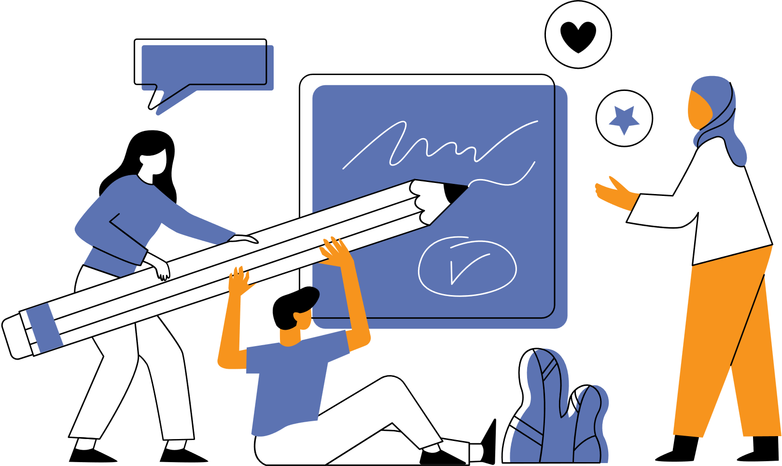


Be a Trusted Advisor, not just a Service Provider
Provide Expertise
on inclusion, accommodations, and workplace accessibility
Offer Training
to hiring managers and staff
Help Problem Solve
when issues arise
Notes:
Employers want solutions, not just candidates. Position yourself as a go-to resource by:
Providing expertise on disability inclusion, accommodations, and workplace accessibility. Leverage resources like the Job Accommodation Network (JAN)
Offering training to hiring managers and staff
Sharing industry best practices and success stories.
Assisting with problem-solving when challenges arise

Slide 5
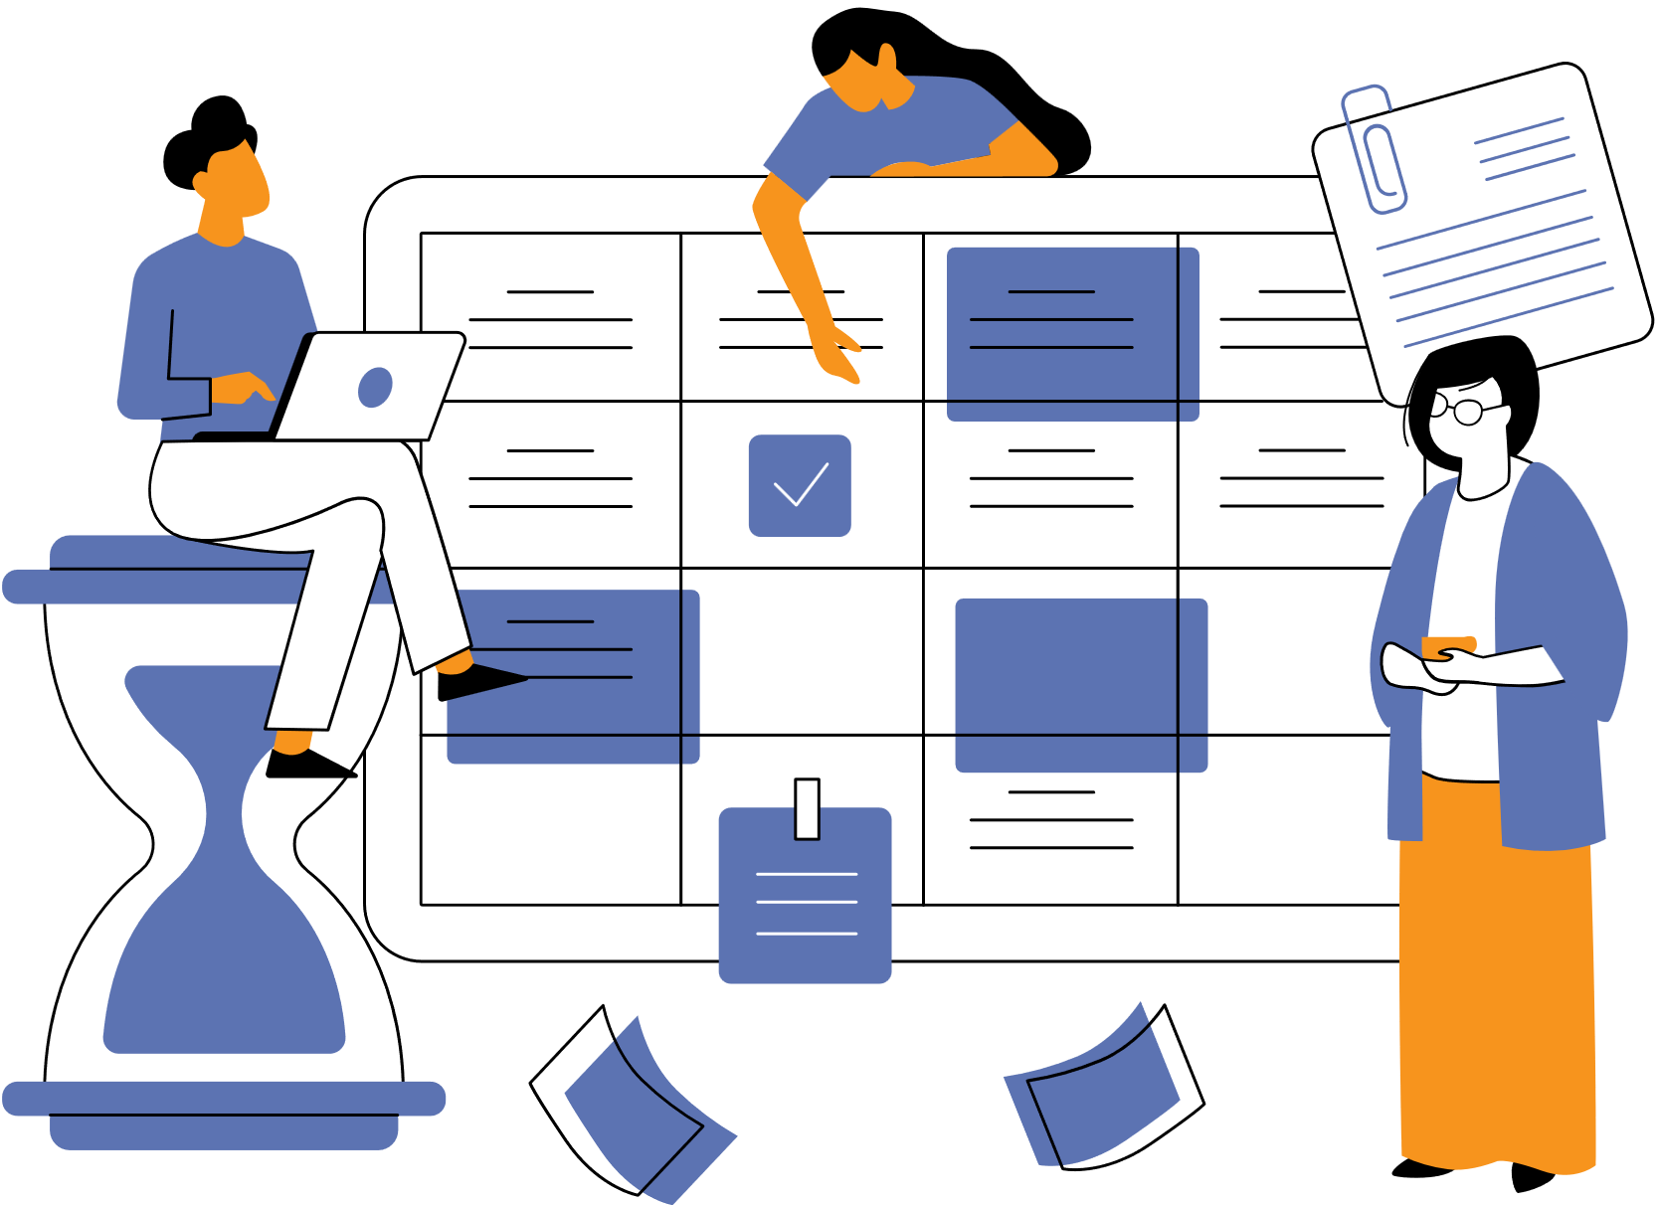

Build Relationships
Build relationships, not transactions!
01
02
Start Small & Build Trust
03
Ongoing Support
Maintain Communication
Strong partnerships require regular check-ins and engagement.
Success with one placement can open the door for more opportunities.
Employers will value you more if they know they can rely on you beyond the initial hiring process.
Notes:
Maintain Consistent and Meaningful Communication
Strong partnerships require regular check-ins and engagement. Consider these approaches:
Initial Meetings: Listen first. Ask about their hiring needs, culture, and workforce challenges.
Ongoing Follow-Ups: Provide updates, success stories, and resources. Check in even when they aren’t actively hiring.
Varied Engagement: Use emails, calls, in-person meetings, and social media to stay connected.
Don't just reach out when you need something—keep the relationship warm year-round.
Start Small and Build Trust
If a business is hesitant, encourage them to start with:
Job shadowing or internships to build comfort with disability inclusion.
A pilot hire before committing to a large-scale initiative.
Attending an employer roundtable to learn from peers.
Success with one placement can open the door for more opportunities.
Offer Continuous Support
Relationships shouldn’t end once a hire is made. Strengthen partnerships by:
Checking in regularly to ensure employer and employee success.
Providing guidance on workplace accommodations and problem-solving.
Offering training refreshers or leadership development on disability inclusion.
Employers will value you more if they know they can rely on you beyond the initial hiring process.

Slide 6


Build Coalitions
Employers trust other employers! Business leaders often feel more confident in hiring when they see others in their industry doing it successfully.
Notes:
Leverage Peer Influence and Recognition
Employers trust other employers. Strengthen relationships by:
Introducing them to other businesses that have successfully hired people with disabilities.
Creating an Employer Champion Network where companies share best practices.
Recognizing their efforts publicly through awards, social media, or press features.
Business leaders often feel more confident in hiring when they see others in their industry doing it successfully.
Get Involved in Business Networks
Go where business leaders are already engaged:
Chambers of Commerce
Industry Associations
Local Workforce Development Boards
Attend networking events, present at industry conferences, and position yourself as a valuable resource in their professional circles.
Celebrate Success and Show Gratitude
A simple thank-you note or shoutout on LinkedIn can go a long way.
Share success stories that highlight their positive impact.
Acknowledging their efforts strengthens the relationship and encourages them to do more.

